Slide 1
Unit 4
What’s the best movie theater?
Unit 4
What’s the best movie theater?
Section B 2a-2e

Slide 2
warmer
the tallest girl
the most outgoing teacher
the best chess player
Mr./Miss.“THE”
the funniest boy
the most talented dancer
the most handsome boy
the loudest singer
the fastest runner

Slide 3
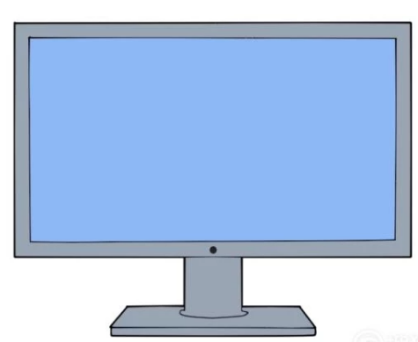

Do you like talent shows?

Slide 4
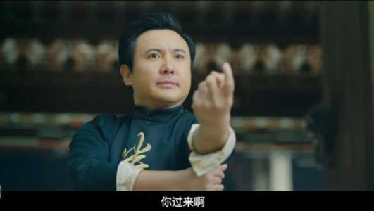
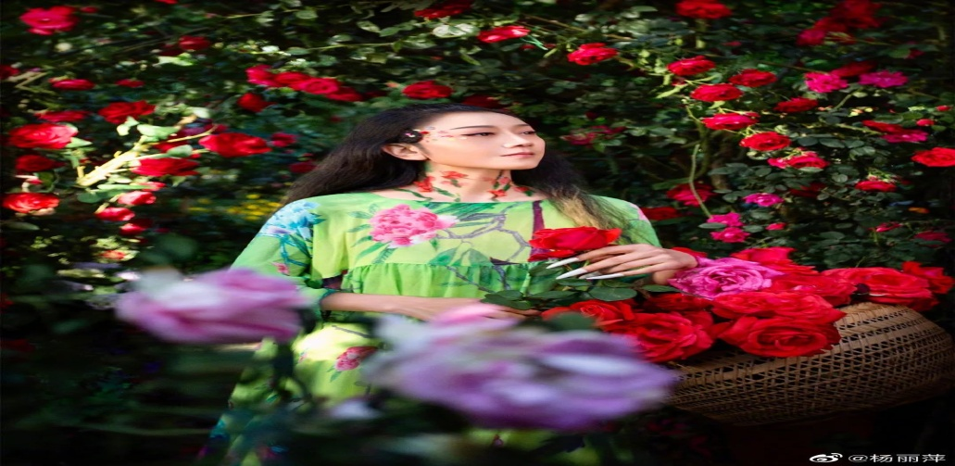
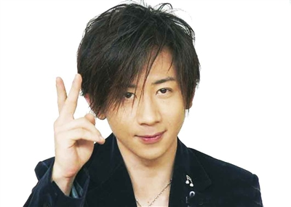
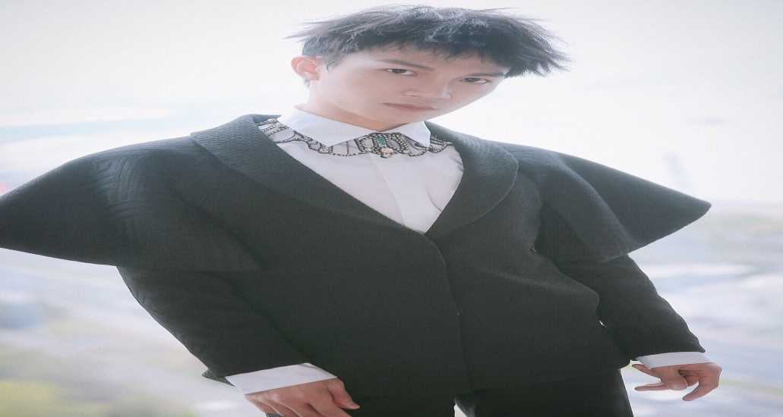
words
I think he is the funniest actor.
I think he is the best singer.
I think he is the most talented dancer.
think he is the most talented magician.

Slide 5

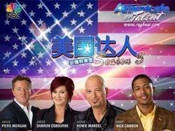
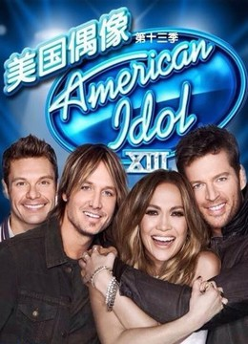
What do these shows have in common?
They try to look for the most talented people.

Slide 6
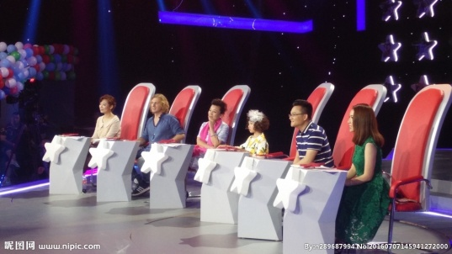
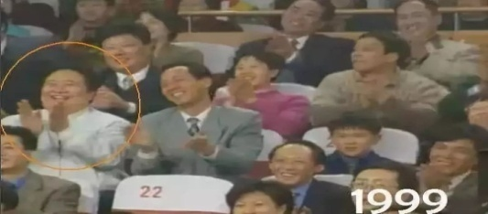
Who decides the winner?
Is it up to the judges or the audiences?
be up to 由… 决定
The audiences
The judges

Slide 7
Reading and predicting
1. What does the title mean?
Who’s got talent?
Who has got talent?
谁是达人？
2. what’s the passage about?
A. Two talented girls.
B. Talent shows
C. The most talented people

Slide 8
Read and match.
a. Two different ideas.
Para. 1
b. popular talent shows.
Para. 2
c. one common thing.
Para 3.

Slide 9
Read para. 1 and answer.
1. How are these talent shows now?
Getting more and more popular.
2. How do people feel when they watching other people show their talents?
Interesting.
3. How many talent shows are mentioned?
Three.

Slide 10
Read para. 2 and judge.
1. Only actors can join these shows.
2. All these shows try to look for the most talented people.
3. The performers play a role in deciding the winner.
4. The winner always gets nothing at last.

Slide 11
Read para. 3 and fill in.
Does everyone enjoy these shows?
People who like the shows think that if you don’t these shows too , they are fun . And they give people to make their dreams .
take
seriously
to watch
a way
come true
lives of the performers
People who dislike the shows think that the are .
made up

Slide 12
opinions
What does the author think of talent shows?
What about you?

Slide 13
D o you want to join the talent shows?
What’s your talent?
Everyone is good at something.
Do best in what you like and become talented.
Make your dreams come true.

